Slide 1
Pneumonia Detection Using CNN
Group-10 Members:
Likhitha Tadikonda - AP19110010006
Yogitha Goli - AP19110010320
Praharshini.J - AP19110010461

Slide 2
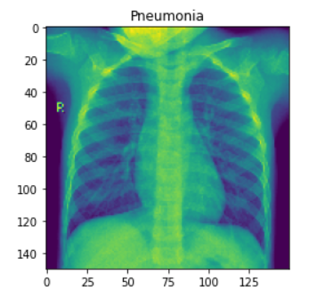
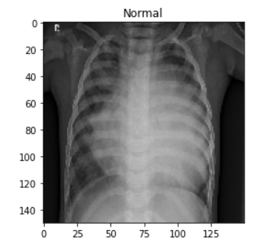
Dataset: (2.31Gb)
Dataset Type | Normal (Class=1) | Pneumonia (Class=0)
Train | 3875 | 1341
Test | 7 + 172 (FP+TP) | 383+62 (TN + FN)
= 5216
= 624
positives[0]
negatives[4]
#Pneumonia- Class 0
#Normal - Class 1

Slide 3
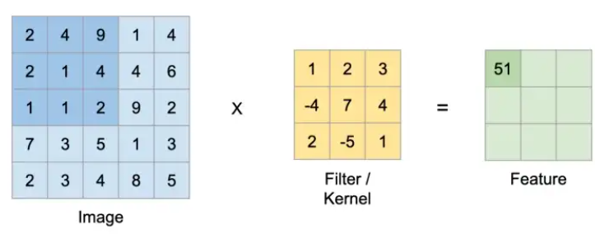
What model ?
Convolutional Neural Network
Feature size = ((Image size − Kernel size) / Stride) + 1
= (150 - 3/1)+1
=148
Convolutional Layers, Max Pooling Layers
ReLU (Rectified Linear Unit) Activation Function- HIDDEN LAYER: piecewise linear function that outputs the input directly if is positive i.e. > 0, otherwise, it will output zero. => ReLU(x)=max(0,x)
Sigmoid - OUTPUT LAYER
Fully Connected layers
Notes:
As the number of epochs increases, more number of times the weight are changed in the neural network and the curve goes from underfitting to optimal to overfitting curve.

Slide 4
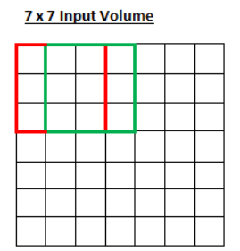
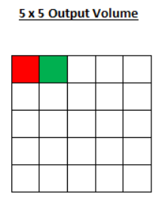
Striding:
3 Convolutional Layers
3 Max Pooling Layers
PARAMETERS:
Learning rate(lr) : 0.0010
activation='sigmoid'
3*3 , Stride= 1 —---------------- Convol
2*2, Stride = 2 —---------------- Pooling
Epochs : 50
optimizer = "adam" , loss = 'binary_crossentropy' , metrics = ['accuracy']

Slide 5
Approach:
Output
Input
Fully Connected Feedforward NN
Convul Layer 1
Dense Layer
Max Pooling Layer 1
Flattened
Convul Layer 2
Max Pooling Layer 3
Convul Layer 3
Max Pooling Layer 2

Slide 6
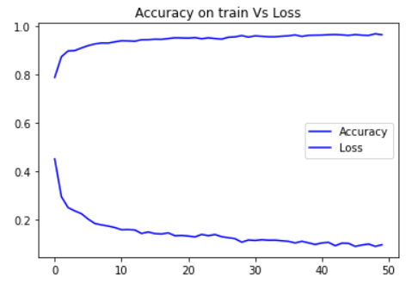
Results:
Convol Layer 1 : 32 filtered 3*3,stride=1
Pooling Layer 1 : pool_size=2*2 ,stride=2
Convol Layer 2 : 64 filtered 3*3,stride=1
Max Pooling Layer 2 : pool_size=2*2 ,stride=2
Convol Layer 3 : 64 filtered 3*3,,stride=1
Max Pooling Layer 3 : pool_size=2*2 ,stride=2
Flattened : (19*19*64) = 23,104
Dense : +1
Fully Connected Feedforward NN: = 23,105
Parameters: 36928 → 23105
Train accuracy: 96.36%
Test accuracy: 88.94%
Loss : 0.355%

Slide 7
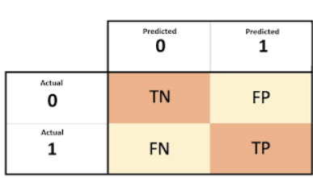
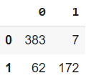
Presentation of result :
Output
(150*150*1)
=23,105
Input
Fully Connected Feedforward NN
Convul Layer 1
(150*150*32)
Dense Layer
(*1)=23,105
Max Pooling Layer 1
(19*19*64)
=23,104
(75*75*32)
Flattened
Convul Layer 2
75*75*64
Max Pooling Layer 3
(19*19*64)
Convul Layer 3
(38*38*64)
Max Pooling Layer 2
(38*38*64)

Slide 8

Notes:
https://github.com/mkldhz/Pneumonia-Detection-from-Chest-X-ray-Using-Convolutional-Neural-Network

